Slide 1

Capstone Design Team #14
Healthcare Telepresence Robot
Team Members:
Fernando Boaro
Chongdan Pan
Niyiqiu Liu
Ruixing Zhou
Tianyu Qiu
Sponsor:
Prof. Pradeep Ray
Instructor:
Prof. Yunlong Guo

Slide 2
Project Intro
Problems
When caregivers are far away from the Elderly:
Inconvenience for Medicine Care
Lack of Video Calls
Sense of Loneliness of the Elderly
Healthcare Telepresence Robot^{[1]}
Needs
In-time Basic Medicine Care
Video Call Support
Improvement the Elderly’s Sense of Happiness
2

Slide 3
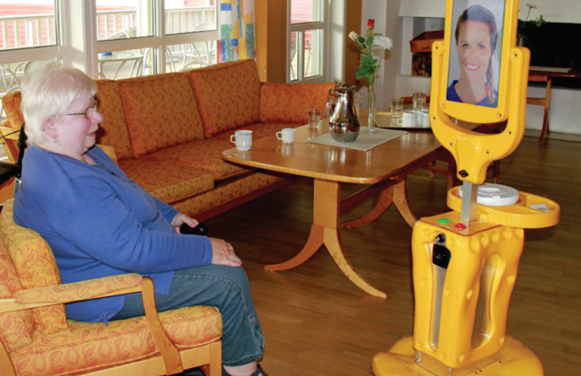
Project Intro
Current Product
High cost, more than $5000
Function Failure
Firewall Interruption
Heavy Video Frame Drop
Heavy Drive Lag
Customer Requirement
Low Budget
Under $1000
Simplification
Essential Functions
Video Call Support
Smart Medicine Dispenser
Individual Customization
Stable Remote Control
Firewall Interruption Free
Short Lag
Figure 1: Giraffe Robot in Use
3

Slide 4
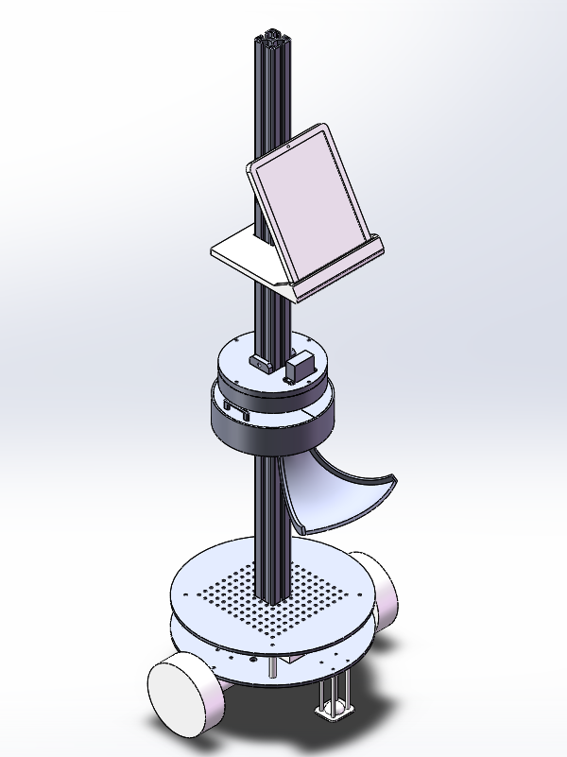
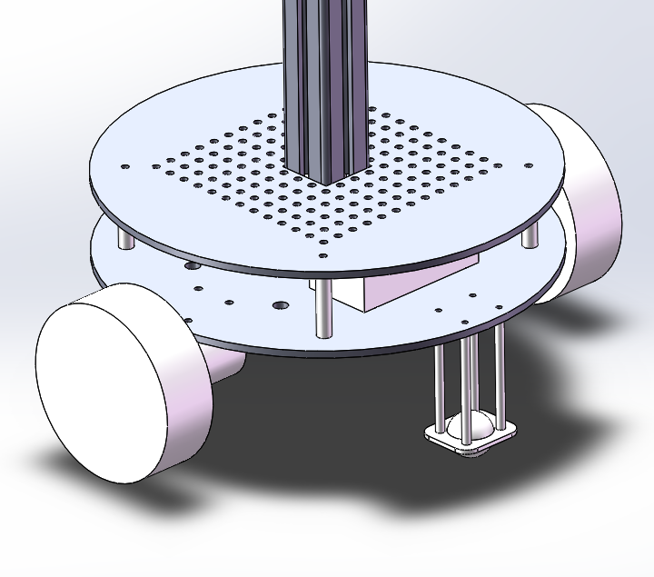
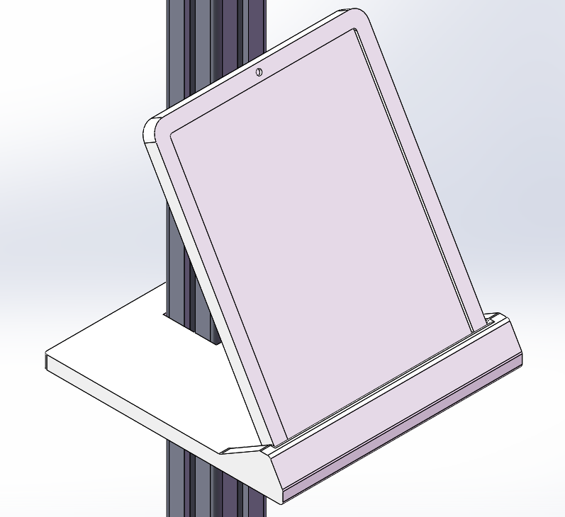
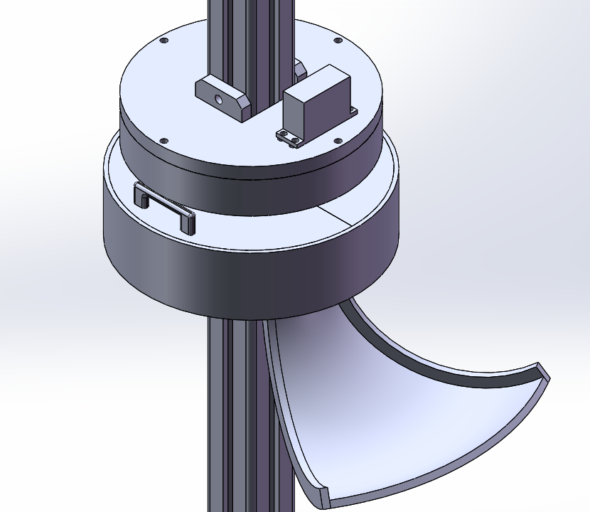
Concept Diagram
Figure 3: Screen for Video Calls
Figure 4: Medicine Dispenser
Figure 5: Chassis of the Robot
Figure 2: Concept Diagram for the Robot
4

Slide 5

Concept Design
Remote Control System
Screen
Medicine Dispenser
5

Slide 6

Remote Control System
Design A: TeamViewer
Parameters
User Interface: Graphic
Required Parameters for Connection:
None
Encryption Standard: 256bit AES
Device Support: Phones, Pads, PCs…
Figure 6: TeamViewer
6

Slide 7

Remote Control System
Design A: OpenBSD Secure Shell (OpenSSH)
Parameters
User Interface: Command Line
Required Parameters for Connection:
IP address
Username and Password
Encryption Standard:
RSA with SHA-2 hash functions
Device Support: PC Only
Figure 7: OpenSSH
7

Slide 8
Screen
Design Selection
 | TeamViewer | OpenSSH
User Interface | Graphic UI | Command Line UI
#Parameters for Connection | N/A | 3
Encryption Standard | 256bit AES | RSA with SHA-2 hash functions
Device Support | Phone, Pad, PC… | PC Only
8

Slide 9

Screen
Engineering Specifications
Screen Size:
$≥$127mm$×$170mm (7 inches)
Font Size: $≥$ mm$×$ mm
DPI: $≥$1280$×$720 pixel
Loudness: $≥$70dB in maximum (1m away)
Language Support: $≥$3 kinds
Video/Audio Lag: < 0.3s
Figure 3: Screen for Video Calls
9

Slide 10
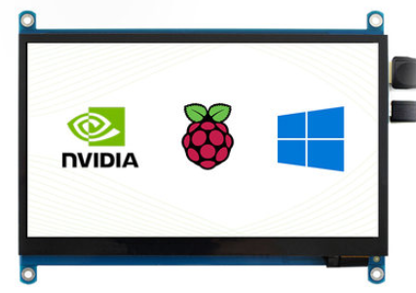
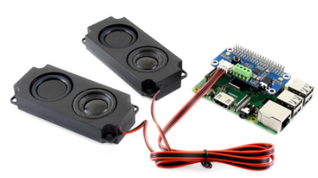

Screen
Design A: Screen for Raspberry Pi with Speakers
Parameters
Screen Size: mm$×$ mm (7 inches)
Font Size: mm$×$ mm per character
DPI: 1280$×$720 pixel
Loudness: 94dB in maximum (1m away)
Language Support: 6 kinds
Video/Audio Lag: > 1s
Cost: 350RMB
Figure 8: Screen for Raspberry Pi
10

Slide 11
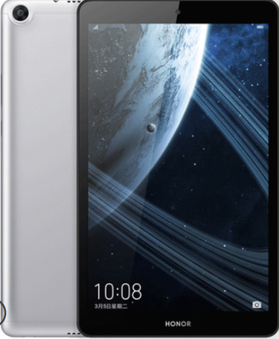

Screen
Design A: Honor Pad 5th Edition
Parameters
Screen Size: mm$×$ mm (8 inches)
Font Size: 5mm$×$5mm per character
DPI: 1920$×$1200 pixel
Loudness: 80dB in maximum (1m away)
Language Support: 60 kinds
Video/Audio Lag: < 0.1s
Cost: 950RMB
Figure 9: Honor Pad 5th Edition
11

Slide 12
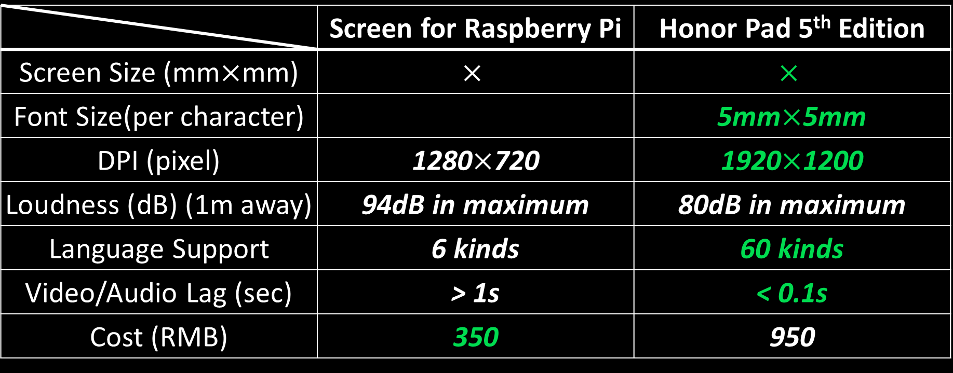
Screen
Design Selection
 | Screen for Raspberry Pi | Honor Pad 5th Edition
Font Size(per character)
DPI (pixel)
Loudness (dB) (1m away) | 94dB in maximum | 80dB in maximum
Language Support | 6 kinds | 60 kinds
Video/Audio Lag (sec) | > 1s | < 0.1s
Cost (RMB) | 350 | 950
12

Slide 13
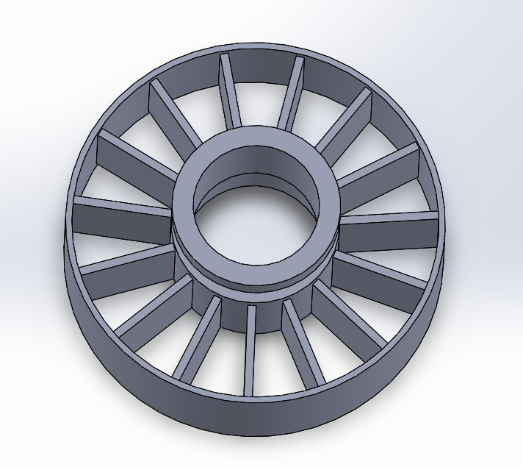

Medicine Dispenser
Design A: Merry Go Round Structure
Parameters
Pill Storage: one dose per block
Probability of Getting Stuck: <10%
Separation Way:
Manual Separation by Dose
Function Implementation:
One 360$°$ Servo Motor
Figure 10: Merry Go Round Structure
13

Slide 14
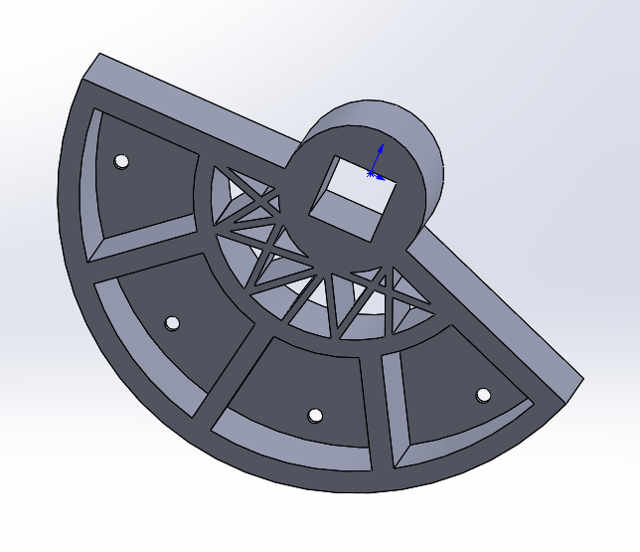
Medicine Dispenser
Design B: Soda Fountain Structure
Parameters
Pill Storage: one kind per block
Probability of Getting Stuck: >40%
Separation Way:
Manual Separation by kind
Function Implementation:
Four Independent Servo Motors
Figure 11: Soda Foundation Structure
14

Slide 15
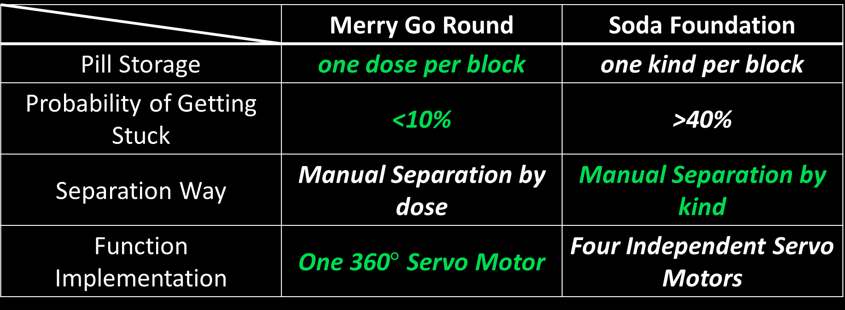
Medicine Dispenser
Design Selection
 | Merry Go Round | Soda Foundation
Pill Storage | one dose per block | one kind per block
Probability of Getting Stuck | <10% | >40%
Separation Way | Manual Separation by dose | Manual Separation by kind
Function Implementation | One 360$°$ Servo Motor | Four Independent Servo Motors
15

Slide 16
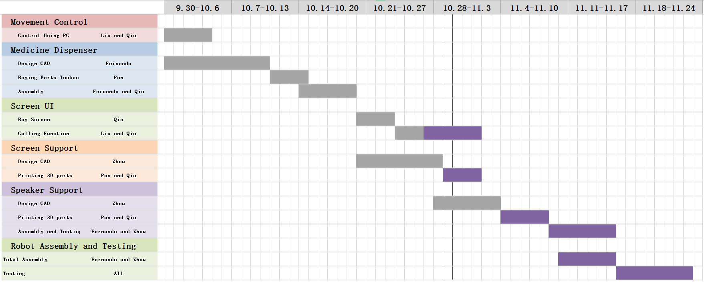
Project Schedule
Figure 12: Project Gantt Chart
16

Slide 17
Conclusion
“A Healthcare Telepresence Robot that supports video calls, smart medicine dispensation and remote control”
Figure 2: Concept Diagram for the Robot
17

Slide 18
Q & A

Slide 19
References

